Slide 1
USER INSTRUCTIONS
PROJECT | Knysna Primary School | Address | Long St, Knysna Central, Knysna, South Africa
KWp | 22.41 | ZAR per cell | 67.00 | Cells per module | 144
IRR | 11.53 | USD per cell | 4.62 | W per module | 415
Lease rate | 1.5 | BTC per cell | 0.00008 | No. of modules | 54
Cell owner rate | 1.25 | Service fee | 16.51
EPC | Specialised Solar Systems | Manufacturer | Canadian Solar | Annual Elect Gen | 34603
Inverter Euro Efficiency | 98.5 | Daily Net Income | 0.01 | DC/AC Losses | TTTA/TTTB
No. of cells | 7776 | 100% - Service fee | 83.49
W per cell | 2.88 | Dealer Mark up | 22 | Elevation above sea level | Sea level

Slide 2
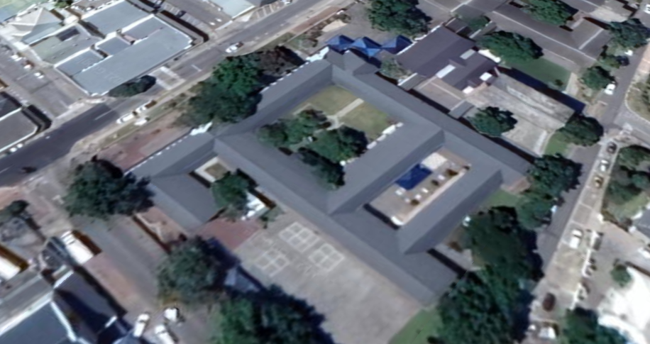
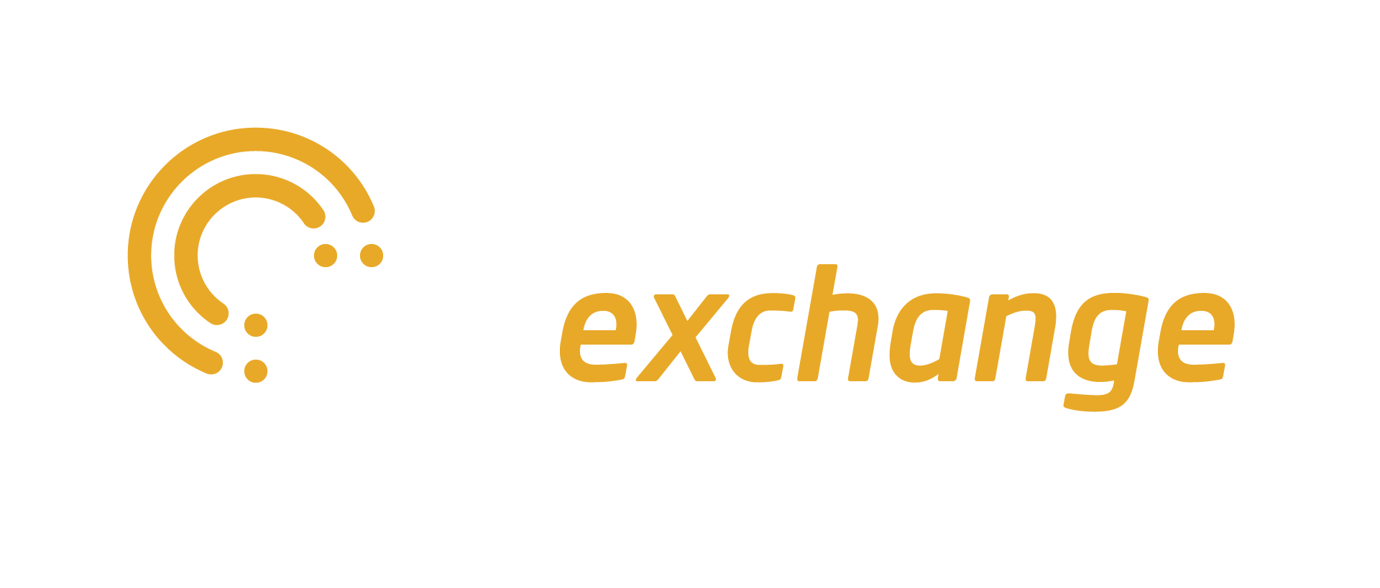
CROWD
OWN & EARN
Solar PV cells powering a 22.41kW solar plant for
Knysna Primary School | Long St, Knysna Central, Knysna, South Africa
SALE

Slide 3
OVERVIEW
This document describes how to purchase solar cells that will be installed onto Knysna Primary School and earn an estimated rental income equivalent to 11.53% IRR through a 20year lease.
Currency Guide (1)
ZAR | 67.00
USD | ~4.62
BTC | ~0.00008
Offer | Purchase silicon solar cells to be installed in a complete solar system leased via a special purpose corporation for the Knysna Primary School Solar Project.
Eligibility | Anyone, subject to identity verification, may purchase solar cells
Price | Fixed at South Africa Rand (ZAR) 67.00 per cell. ZAR and BTC accepted.
Quantity | 7776 cells available (~2.88 W per cell)
Lease Term | 20 years (2)
Lease Rate | ZAR 1.5/ kWh to the energy consumer. After insurance and servicing fees, Cell Owners estimated to receive ZAR 1.25 / kWh, equivalent to a ZAR linked 11.53% Internal Rate of Return (IRR) for 20 years. Each nation and jurisdiction has its own laws and regulations governing the offering of financial and other products that enable a purchaser to earn income over time. In the event we reasonably determine that the sale of solar cells and subsequent payment of lease rental to you in excess of your original purchase price would require us to register the sale as a securities offering, or obtain an exemption under securities laws or regulations in your jurisdiction, we have the option to not pay you rental income in excess of your original solar cells purchase price, and instead donate only those excess rental amounts received from Knysna Primary School to the project’s designated charity.

Slide 4
OVERVIEW
Notes from previous page
As of date of publishing of this document.
The Solar Cells Owners Lease becomes effective when this sale ends, and terminates 20 years after the solar system becomes operational. You may notify us of your intention not to enter the lease and physically receive your solar cell and forgo its installation into the project, otherwise you will be deemed to enter into the lease agreement.
Forecast maximum internal rate of return if leased for the full term. Includes insurance premiums, taxes, fees and expenses to Specialised Solar Systems, The Sun Exchange (SunEx) and others. Forecast is based on a P50 solar yield. Effective lease rate may be higher or lower due to home country tax benefits, currency values, and others. Please read the terms and risk factors in this Product Information document for more details.

Slide 5
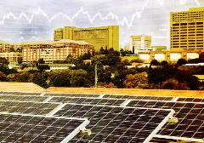
HOW IT WORKS
Your solar cells will be leased to Knysna Primary School as part of a 22.41 kWp solar energy system
Your solar cells produce electricity on a predictable schedule
Knysna Primary School will pay you for each kWh of electricity generated by your solar cells
The Sun Exchange platform arranges all the leasing and rental collection so you receive a solar-powered rental stream automatically.
You may access real-time solar energy production data to track the performance of your solar cells in real-time.
Video Tutorial 1: How it works

Slide 6
RENTAL INCOME & FEES
In Year 1, Knysna Primary School will pay ZAR 1.5* for each kWh of solar electricity generated by your solar cells. This pie chart shows how this income will be divided in Year 1.
‘Service Fee’ covers insurance (fire, theft and damage/liability), ongoing maintenance (annual cell cleaning), contributions to a maintenance reserve and administration services.
*Annual lease rate will escalate at CPI + 2% per year

Slide 7
20 YEAR INCOME PER SOLAR CELL
The rental rates for your solar cells is set to increase by CPI + 2% per year. This chart shows how your rental income is expected to increase over time assuming CPI is 5%.

Slide 8
SOLAR POWERED MONEY
Buying solar cells through The Sun Exchange is easy.
Create an online account at www.thesunexchange.com
Complete the identity verification process
Choose your currency and make payment in ZAR 67.00 or ~BTC 0.00008 increments (the price of each cell). You can pay by credit card, bank transfer, Bitcoin and directly from your Sun Exchange ZAR or Bitcoin wallet.
Your payment is held in a separate account ⁽¹⁾ until the required number of cells are sold or the sale ends.
For Bitcoin payments, you may place an Order where the number of solar cells allocated will depend on the ZAR/BTC exchange rate when the sale ends. ⁽³⁾ The Sun Exchange tracks the Bitcoin value. Check your dashboard to track how many cells your Variable order entitles you to. You can only buy whole units, so any unused BTC will be returned to your wallet at the end of the crowd-sale period.
This crowd-sale ends 30 days after crowdsale open announcement or when all the solar cells have been sold, whichever is sooner ⁽²⁾
You cannot cancel your order before the crowd-sale ends. If we terminate the sale early, or if all the solar cells are not purchased, your money will be returned in full in your payment currency.
See the Foreign Exchange Schematic in the Appendix for more details. ZAR payments kept at in trust in ABSA Bank. BTC is kept in cold storage.
Our website will show sale progress towards the target. Sale end many occur quickly and without warning.
Immediately prior to sale end, BTC required to buy integer numbers of solar cells will be exchanged to ZAR, inclusive of any foreign exchange commissions we pay to third parties. Excess BTC amounts will be returned to the account holder. We may use exchange rates and fees that reflect conditions in international currency markets at the time, in our sole and absolute discretion. BTC exchange rates can be volatile and unpredictable; we accept no liability for foreign exchange losses or fees

Slide 9
GETTING PAID
How you get paid your rental income depends on your purchase currency and where you live. Tip: The video tutorials on the right hand side of this page give a visualised explanation
IF YOU PURCHASE YOUR SOLAR CELLS IN ZAR FROM A ZAR ACCOUNT
You will receive lease rental at least monthly paid in ZAR into your nominated ZAR account but you can opt in to receive Bitcoin at any point.
IF YOU PURCHASE YOUR SOLAR CELLS IN BITCOIN OR FROM A NON-ZAR ACCOUNT
We will convert your ZAR rental income into BTC and send payments via the universal Bitcoin digital currency network. ZAR is converted to BTC once a month using the ZAR/BTC spot price at that time.
IF YOU PURCHASE YOUR SOLAR CELLS USING SUN EXCHANGE WALLET BALANCES
You can contribute to an order or pay for an entire order using BTC or ZAR balances on your Sun Exchange dashboard. You can supplement your balance with an additional payment by credit or debit card, bank transfer or Bitcoin payment.
See this blog feature for more information.
Video Tutorial 2: Getting Paid
Video Tutorial 3:
Paying with Bitcoin

Slide 10
FAQ
WHAT IF THE SOLAR PLANT BREAKS DOWN?
The solar plant will be under an installation defects warranty for the first 2 years. The inverter is under warranty for 10 years and the solar panels have 25 year power output guarantee. After year 2 a pre-determined portion of the lease rental income will go into a reserve maintenance fund to finance any remedies that are not covered by the fire, theft and damage insurance policy that will be in place for the duration of the lease period. The estimated lease rental income illustrated to you takes into account these maintenance reserve payments.
ARE THE CELLS STILL MINE AFTER THE 20 YEAR LEASE?
At the end of the 20 lease term your solar cells still belong to you but they are approaching the end of their design life. Sun Exchange will assist in negotiating an additional 5 year lease, or, selling the cells and the rest of the system to the customer for an estimated residual value which will be returned to you.
WHY IS THE PROJECT NOT FUNDING THE SOLAR PLANT THEMSELVES?
Leasing the solar plant reduces their overall energy costs without having to deploy their own capital. Many organisations view electricity as a variable cost and would rather not use their working capital to fund energy generating hardware. Leasing the solar plant is an easier business decision as it gives them instant access to lower energy bills with a fully serviced solution without having to own it.
CAN I BUY SOLAR CELLS IN MULTIPLE PROJECTS?
Of course and we encourage this. Owning solar cells across multiple project mitigates the economic impact on you in the event of an isolated default on a single project and spreads the social and economics impact you can create.

Slide 11
FAQ
ARE THERE ANY GUARANTEES IN PLACE THAT THE SOLAR CELL LESSEE WILL
HONOUR THE 20 YEARS OF LEASE PAYMENTS?
The lease is legally binding for 20 years. In the event of a default the solar plant may be relocated to another project or a new building occupier may take over the lease. The Sun Exchange has ‘skin in the game’ as we own the remainder of the solar plant and receive on-going service fees. We don’t host projects that we don’t believe will fulfil the lease term.
ARE THE ESTIMATED RETURNS GURANTEED?
The income you will receive is entirely linked to the amount of electricity your solar cells produce and which is purchased by Knysna Primary School. The income estimates provided are based on forecasts of the electrical production of your solar cells with a >50% probability of meeting or exceeding the forecast.
IF I PAY FOR CELLS BY CREDIT CARD / ZAR, CAN I GET MY RENTAL INCOME PAID IN BITCOIN?
Yes you can. There is a setting for this when you set-up your account and you can change this setting at any time.

Slide 12
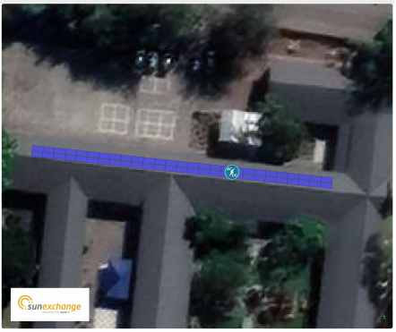
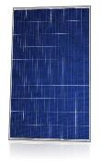
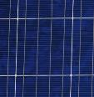
YOUR SOLAR CELL
Your solar cells are manufactured by Canadian Solar. ⁽¹⁾
Your solar cells will be installed as part of a 22.41 kWp rooftop solar system on the roof spaces in the image below:
Solar cells are the ‘business end’ of a solar energy system and are mounted in modules of 144 cells. Knysna Primary School requires 7776 solar cells totalling 22.41KWp, that is 54 x 415W solar modules.
Silicon cell- based solar module
Long St, Knysna Central, Knysna, South Africa
Silicon cell
The indicative solar system data sheet is included in this product information document. The final choice of the manufacturers and the type of components may differ from the product described, but will be equal to the requirements and quality standards as indicated here

Slide 13
OWNING A SOLAR CELL
OWN SOLAR CELLS LOCATED IN THE SUNNIEST CONTINENT ON EARTH AND GENERATE SOLAR-POWERED RENTAL
OUR SERVICES
Purchasing a solar cell enables you to lease them such that businesses can power their operating equipment. We arrange the lease agreements, insurance coverage, equipment maintenance and other contracts when you complete your purchase.
You also have the option to acquire physical possession of your cells when you purchase.
A market to purchase tier 1 solar cells (rated at ~2.88W per cell)
Registration of your cells and arrangement of leases
Deployment of your cells in a complete solar installation, plus insurance and ongoing maintenance
Provision of a dashboard to track the performance of your solar cell and a robust payment process
+
+
+
Purchase solar cells and lease them for 20 years
Knysna Primary School pays for all the electricity generated by the system
Rental doesn’t depend on government tax breaks or special tariffs
The crowd-sale of solar cells enables us to purchase supporting equipment such as mounting structures, inverters, cables, etc.
We estimate a ZAR 11.53% p.a. rental IRR over the 20-year term
You may be able to sell your solar cells through a secondary market
We will give you a reference number for each cell giving you its exact physical location so you can even visit it!

Slide 14
The energy used to make a solar panel is paid back in less than 1 year of it operating.

Slide 15
SYSTEM PARTICIPANTS
Knysna Primary School
System lease agreement
services
EPC & O&M services agreement
^{Specialised Solar Systems}
Sun Exchange Bewind Trust
The Sun Exchange (Pty) Ltd
services
Solar cell owners lease agreement
services
Lessors of solar cells

Slide 16
SYSTEM PARTICIPANTS
LEASE OF THE SYSTEM INVOLVES THE FOLLOWING PARTIES:
PARTY | ROLE
You / Lessor | Lessor of the solar cells to Special Purpose Corp
Knysna Primary School | Solar energy Consumer, that leases the system from Special Purpose Corporation
Specialised Solar Systems | Engineering, procurement, construction and maintenance of the solar system
ABSA Bank, or other financial institution | ZAR accounts for solar cell rental collection and payments
Luno | Digital currency exchange transactions
Sun Exchange Bewind Trust | Lessor of the entire solar system to Knysna Primary School
The Sun Exchange | Provider of marketplace and various services. Owns and leases the balance of system equipment to SPC
Knysna Primary School
Consumer, Lessee
Specialised Solar Systems
The Sun Exchange (Pty) Ltd
EPC to install and maintain equipment
Provider of various services including Marketplace
ABSA
Bank
Sun Exchange Bewind Trust
ZAR accounts
Leases solar cells from Cell Owners, Leases System To Knysna Primary School
Marsh Proprietary Limited
Luno
BTC exchange services
Equipment and public liability Insurance

Slide 17
DESIGNATED CHARITY
African Parks is a non-profit conservation organization that takes on direct responsibility for the rehabilitation and long-term management of protected areas in partnership with governments and local communities. https://www.africanparks.org/

Slide 18
The sun produces enough energy in one second to power the United States for 9 million years.

Slide 19
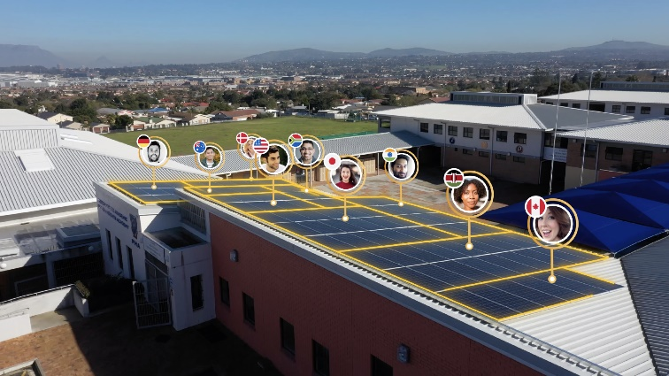
THE SUN EXCHANGE
The Sun Exchange is an online marketplace where anyone can buy solar cells and lease them in technically and economically validated commercial solar projects
Owner (Lessor) clients value our variety of globally distributed solar energy projects to obtain an ethical clean energy rental stream.
Commercial and enterprise (Lessee) clients value the access to solar energy that reduces their operating expenses, stablises their power supply, lowers their carbon emissions and promotes stakeholder engagement in their community
The Sun Exchange originates commercial solar energy projects
Money from our sale of solar cells covers system installation and other costs. The electricity Consumer rents the system.
Lease rental is collected and paid on at least a monthly basis in accordance to actual electricity production.
www.thesunexchange.com

Slide 20
PROVIDING SUPERIOR SERVICE VIA TECHNOLOGY
BLOCKCHAIN SMART CONTRACTS
The Sun Exchange is promoting the representation of solar cells onto commercial contracts in computer code on the blockchain. Shared by a decentralized network of computers, these contracts are transparent, permanent and resistant to “hacking”. Smart contracts automatically execute objectively. For example, smart contracts could automatically debit the Lessee’s account and transfer funds to lessors for each 1 kWh generated at a system without human intervention. This would reduce operational risks and errors over long-term solar projects.
Distributed ledgers
Financial and operational data recorded on a public blockchain would be secure, stable, transparent, and tamper-proof. The Sun Exchange wants to ensure our account holders avoid the type of personal identify theft and data falsification we frequently see in the financial world today
Smart-metering
IoT data-loggers embedded in each solar plant measure electrical output and could govern the distribution of funds as each unit of electricity is generated. As a result, lessors could receive rental payments that follow the timing of electricity production, rather the timing of corporate events or the calendar. Real-time rental distribution increases trust and confidence levels for our solar cell lessors. It can create a sense of interactivity between you and your solar cells, which could be on the other side of the world. If the electricity Consumer cannot make his payments, the system could be automatically disconnected until payments resume.
Digital currency fund transfers
Digital currency has removed the friction and costs normally associated with international remittance. The efficiencies of bitcoin allow us to make micro-payments in near-real time at low cost. This means that as long as the sun is shining, you can see your money working.
Transferring local (fiat) currency between countries is often expensive and time consuming. We accept bitcoin so that you can purchase solar project assets wherever you are in the world quickly, easily, and transparently.

Slide 21
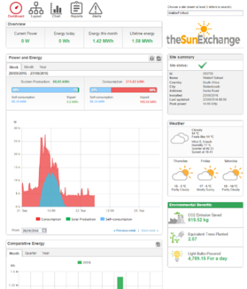
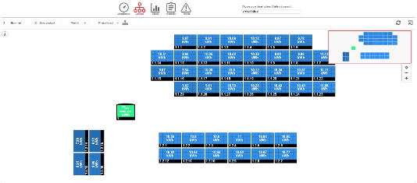
PROVIDING SUPERIOR SERVICE VIA TECHNOLOGY
You needn’t wait for quarterly reports or press releases to know how your solar cells are performing. The Sun Exchange gives you access to real-time performance data and track rental income generation.

Slide 22
DOING GOOD IS GOOD BUSINESS
OUR VISION
OUR MISSION
A world powered by clean energy and financed by decentralized capital.
To connect the world to the sun.
SAFETY FIRST | We arrange independent financial and engineering checks. We look at counterparties’ safety track records. In future we aim to have contracts and data stored on a tamper-proof, globally distributed block-chain
SKIN IN THE GAME | We are involved. We own the balance of system (mounting structure, cabling and inverter equipment) and directly lease the system to the energy Consumer
RESPONSIBILITY | We support the global effort to prevent money laundering and the financing of socially unacceptable activities, and verify the identifies of our customers.
WHAT WE DO
Originate new solar project opportunities
Assess project viability with thorough industry standard due diligence processes.
Vet engineering (EPC) providers
Engage local operation and maintenance providers
Monitor Lessee account pre-payments
Structure the lease and other contracts
Arrange for equipment insurance coverage
Provide and lease Balance of System equipment
Design, plan, execute online crowd sales
Establish accounts to segregate funds
Arrange foreign currency / digital currency transactions
Monitor adherence to compliance regulations
Arrange international payments and money transfers
Outsource identity, KYC, AML checks
Collect, disclose project operational and financial data
Monitor equipment performance using solar smart meters
Arrange distribution of lease rentals
Maintain project books and records
HOW WE MAKE MONEY
Dealer mark-up on project value
Servicing fees from rental payments.
Ownership of plant balance equipment, operational and financial data, renewable energy credits

Slide 23
As of June 2015, there was at least 180GW of solar PV panels installed globally. That is the equivalent energy output of 38 Fukushima Nuclear Power Stations and cost less to build.

Slide 24
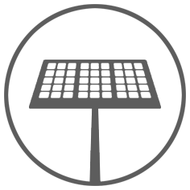
ABOUT THE SOLAR PV PLANT
EQUIPMENT
SOLAR YIELD
SITE
Solar PV System | 22.41 kWp DC Roof Mount PV System
Solar Panel Type | Crystalline Silicon
Manufacturer | Canadian Solar Solar
Standard Compliance | IEC-62103 (EN50178), IEC-62109, AS3100
Installation Standard | To meet NRS097 and SANS10142 codes.
Mounting system | Fixed mounting
Azimuth/inclinations | Various
Inverter Euro eff. | 98%
DC/AC losses | TTTA% / TTTB%
Availability | 99.0%
Est. Annual Generation | 34603MWh
Probability Factor | 50%
Y1. R/kWh | 1.5
Site Name | Knysna Primary School
Elevation a.s.l. | Sea levelm
System usage | 100%
Principal system components Photovoltaic modules Mounting system/rack for the PV modules Inverter/s and transformer (where required) Switch gear and cabling at site
Smart Meter Monitoring The solar plant is kept under surveillance over the internet. The system data is viewable through a portal and can be viewed online by all owners.
SYSTEM LEASE RENTAL ADJUSTMENTS
The base price for system usage will be charged per kilowatt-hour for energy consumed. Adjustments to the base price for Lessee’s payments shall be made on the basis of the following table. The base unit price, as adjusted, will be multiplied by the Asset Output to determine the payments due from Lessee to the Lessor.
Initial per kWh charge | Adjustment Basis | Adjustment Frequency | Adjustment Base Month
R 1.5 | Escalate at CPI +2% per year. | Annual | To coincide with annual anniversary of the COD.

Slide 25
ENVIRONMENTAL IMPACT
Each solar cell you own and lease to Knysna Primary School is expected to offset 84 kg of carbon over the 20 year lifespan of the project. This energy output is equivalent to:
~1,4 Seedling grown for 10 years
Good for your pocket and the planet
In South Africa each kWh of electricity embodies 2.16 lbs (about 0.98 kg) of CO2, almost double that of the USA and Western Europe. Each solar cell in this project will off-set 4 times the green house gas emissions than it would installed in many places in Europe,
~3,2 light Lamps switched to LED
~340 km driven by an average passenger vehicle
Sources: US Environmental Protection Agency, https://www.epa.gov/energy/greenhouse-gas-equivalencies-calculator
Department of Energy’s Energy Information Administration

Slide 26
LEASE AGREEMENT: INITIAL PHASE
RENTAL STARTS WHEN THE SYSTEM IS CONSTRUCTED
Crowd Sale
End
Construction
Complete
End of
Year 1
“Commercial Operation Date”
Rental escalation calculated at the end of Year 1 and annually thereafter
Lease agreement with us is effective at the Crowd Sale End
Cumulative rental (ZAR)
Rental accrues after the Commercial Operation Date
0
There is zero rental before the Commercial Operation Date
Construction period estimate
Planning & Final Design | Construction | Total
2 - 4 weeks | 6-8 weeks | 8 - 12 weeks

Slide 27
TAXATION
YOU MAY BE ELIGIBLE FOR TAX BENEFITS
Over 60 countries have implemented policies to promote solar power generation. The type of subsidy varies considerably, and may include
tax credits
accelerated depreciation
direct payments / grants
tax holidays
educational benefits
Furthermore, if you elect to lease your solar cells under our operating lease agreement, you may be able to deduct depreciation expenses.
In this product information document, we cannot summarize the many national and state tax policies and incentives that exist for clean energy equipment ownership and use. However, as a start, you may find a variety of useful guides available freely available on the Internet
We encourage our customers to consult a tax specialist to learn about potential tax benefits of owning and leasing solar cells.

Slide 28
COLLECTIONS
The Sun Exchange will set up the system through which lease rental is globally distributed to the solar cell lessors
As part of its responsibilities under the Owner Lease and the Terms of Service, The Sun Exchange will:
Calculate and collect rental due from Knysna Primary School. for use of the solar system
Maintain a register of current Solar Cell Owners and Solar Cell Lessors
Calculate and pay fees, expenses, insurance premiums, and scheduled deposits to reserves
Pay to you the lease rental for our use of the solar cells, to the extent there are sufficient funds from the rental under the lease to Knysna Primary School and subject to a monthly maximum amount
Arrange foreign currency transactions for international customers as requested
Notify you if a Force Majeure or other event occurs that delays collection or payment
Provide other notices relating to Knysna Primary School and other transaction parties, as necessary
The Terms of Service for all our Website Users is posted on www.thesunexchange.com;
Copies of the Owner Lease and all relevant documents will be made available to account holders considering purchase and lease of solar cells. Upon placing an order to purchase solar cells on our website and also opting to lease one or more solar cells if purchased, you indicate your agreement with all of the terms and conditions of these agreements, and will be deemed a signatory to those agreements when they become effective

Slide 29
INFORMATION ACCESS
i
The Sun Exchange aims to empower our solar cell Owners by maintaining high standards of transparency and timely access to information
The Sun Exchange undertakes to make frequently available, online or via email:
Knysna Primary School lease rental historical payment data
Historical and/or real-time plant operation data
Maintenance and repairs required and completed
Current balances in Knysna Primary School system lease rental account
Copies of all contracts and other documents relevant to ownership and leasing solar cells
Material information relating to service providers (EPC, O&M, Luno, and others)
Adjustments and escalations of lease rental rates, and system expenses
Insurance premiums, claims and payments. Changes in insurance providers and terms
Amendments to accounts and payment methods
When available, how to access information via the blockchain
Other information relevant to the solar cells

Slide 30
SOLAR CELLS SUMMARY TERMS
Product offered: | Solar cells. Each solar cell is one crystalline silicon cell, with unique identifier, with the technical specifications described in this product information document
Unit Price: | ZAR 67.00 per solar cell
Payment Currencies: | South Africa Rand (ZAR) and Bitcoin (BTC)
Sale Period: | Beginning upon the announcement and ending when total purchases reach the Target Cells Amount, or after 30 days, which ever is sooner
Sale Period Extension: | The Sun Exchange reserves the right to extend the sale period up to an additional 60 days
Pro-User Bonus: | Payable to The Sun Exchange (SunEx) supporters that backed our Indiegogo Campaign. Bonus payments and others available
Payment Accounts: | ZAR trust account, and digital wallet at Luno, as indicated on www.thesunexchange.com
Total Cells Available: | As listed on the crowdsale webpage. If fewer are sold, SunEx will cancel the sale, and return money in the payment currencies. SunEx may reduce the Target Cells Amount at its discretion
Please refer to the Glossary and Terms of Service for definitions. Contact SUNEX with questions at hello@thesunexchange.com

Slide 31
SOLAR CELLS SUMMARY TERMS
Bitcoin Payment | Account holders purchasing in Bitcoin outside South Africa will secure the number of cells afforded by the value of BTC at the time the sale ends. Any BTC excess payments will be returned to the account holder in full in ZAR equivalent.
Allocation Method: | First come first served, with consideration for the number of cells to be deployed into the system, as monitored by Sun Exchange
Purchase Method: | Users that have successfully completed the sign-up process for a Sun Exchange account on www.thesunexchange.com may review solar cell purchase and lease terms and at the time of ordering cells may choose either to take physical possession of solar cells or lease cells within the solar system.
The Sun Exchange Remuneration: | Dealer Markup, which is 22% of the system cost including installation Service Fee, which is 16.51% of the gross rental revenue which covers insurance costs, operations and maintenance and contributions to a maintenance reserve fund. Grant of certain related balance of system equipment to The Sun Exchange (Pty) Ltd. (note: all forecast IRR figures are net of Dealer Markup, service costs, insurance and maintenance)
Please see SunEx’s Terms of Service, Solar Cell Owners Lease Agreement, and Glossary for more information. Contact SunEx with questions at hello@thesunexchange.com

Slide 32
OWNER LEASE SUMMARY TERMS
Option To Lease: | SunEx account holders that purchase solar cells via this sale have the opportunity to opt out of the lease their cells to a Special Purpose Corp (the “SPC”) established by SunEx. The SPC will otherwise deploy those purchased cells together with other solar equipment into the system described in this product information document. The operating lease terms can be found in the Owner Lease.
Lessors: | Solar Cell Owners who elect to enter the Solar Cells Owner Lease Agreement (Owner Lease)
Lessee: | A Special Purpose Corp (SPC) established by SunEx
Authority To Sub-Lease | SPC will lease the entire solar system to Knysna Primary School, including the solar cells, under the terms of a SunEx Lease
Lease Rental Commencement Date: | The Commercial Operation Date (COD). Your money will not accrue lease rental prior to this date, including during the sale period
Events of Default: | Failure to pay amounts payable within 30 days, breach of other terms of the Lease and other agreements not remedied within 30 days, insolvency or analogous event, cessation of business, etc
Lease Rental Accounts: | Accounts for escrow of lease rental paid by the SPC
Lease End Date: | The 20th anniversary of the COD
Please see SunEx’s Terms of Service, Solar Cell Owners Lease Agreement, and Glossary for more information. Contact SunEx with questions at hello@thesunexchange.com

Slide 33
OWNER LEASE SUMMARY TERMS
EPC | Specialised Solar Systems will provide engineering, procurement and construction services to SPC for the system
O&M | Specialised Solar Systems will provide system operations and maintenance services to SPC
The Sun Exchange Lease-Related Fees: | Servicing fees, paid monthly, equal to 16.51% of the rental collected from the Knysna Primary School under the Owners Lease.
SunEx Rental: | In the Owner Lease, for each calculation period, SPC will pay SunEx Rental in ZAR calculated as the Available Balance minus the Project Expenses due. The Available Balance is the Base Rental amount (based on the EEP and subject to a maximum amount per period, as stated in the Owner Lease) or the balance in Knysna Primary School’s rental account, whichever is smaller. Lessors without ZAR accounts will receive amounts converted and paid in BTC
Rental Payment Frequency: | SunEx Rental is due at least monthly, but may be paid more frequently at SPC’s option
Output: | Electricity (DC) generated by the rooftop PV generation plant (the Project) measured in kWh. Live energy data will be made viewable on a data monitoring portal provided by Sun Exchange.
Please see SunEx’s Terms of Service, Solar Cell Owners Lease Agreement, and Glossary for more information. Contact SunEx with questions at hello@thesunexchange.com

Slide 34
OWNER LEASE SUMMARY TERMS
EEP Adjustment Basis: | Rental will escalate annually at CPI + 2% per year on the anniversary of COD.
Commercial Operation Date (COD): | The date on which the EPC partner signs the electrical completion certificate (CoC) confirming the system has been installed and is operational
The Contracts: | Each solar cell deployed in the system will be subject to the terms of the Owner Lease and SunEx’s Terms of Service, which may be amended from time to time. By making a order to purchase through SunEx’s website and electing to deploy cells into the system at that time, each account holder signifies his agreement with those terms, and will be deemed a signatory to the Owner Lease at the end of the sale period as determined by The Sun Exchange in its sole and absolute discretion
Please see SunEx’s Terms of Service, Solar Cell Owners Lease Agreement, and Glossary for more information. Contact SunEx with questions at hello@thesunexchange.com

Slide 35
GLOSSARY
There are many words and acronyms in the world of solar energy and money that are daunting and sometimes even down right bizarre. We don’t want these words to scare you away. More often than not, the concepts behind these words are actually quite simple!
We want to help you learn to ‘speak solar’ so we have put together this glossary of terms for you so you can fully understand the opportunities we are hosting, even if you have never invested in anything before. If you are still confused, drop us an email or contact an Independent Financial Advisor.
Solar cells: A solar cell is physical product. Purchased through The Sun Exchange, you are provided with legal contracts relating to the cells, which make possible its lease. Solar cell ownership enables The Sun Exchange to arrange for the lease of electricity generation equipment to the Consumer, and can generate lease rentals that directly depend on the timing and amount of energy generation, among other things
Unit Price: The cost of one solar cell, which is stated on page 2 of this document.
Project Lease Agreement: An agreement between the SPC and Knysna Primary School establishing the duration, pricing, and other terms of lease of the Solar cells and Solar Equipment.
Solar cell Owners Lease Agreement: An agreement between the special purpose corporation (SPC) and Owners establishing the lease of the solar cells to SPC
SolarCoin: SolarCoin is the world’s largest community solar electricity reward program worth over $9 billion USD*. SolarCoin represents 1 MWh of solar electricity generation. As a verified a solar cell owner you may be entitled to SolarCoins for free. SolarCoins are managed by the SolarCoin Foundation. Sunex is not affiliated with and does not guarantee any obligations of the SolarCoin Foundation.“
Sources: Wikipedia, Investopedia

Slide 36
GLOSSARY
Solar cells Lease Rental: The amount paid to each lessor by the SPC. Lease Rental will effectively be paid to you in return for allowing usage of the solar cells. The Lease Rental is calculated as Energy Output measured in kWh x Per kWh Price, less expenses, taxes, fees, and deposits to reserves
Sale period: The window of time where you can place an order for solar cells. The sale is open for up to 30 days and at our discretion an additional 60 days. Purchases are arranged on a “first come, first served” basis.
Equivalent Energy Price: The price at which Knysna Primary School must purchase electricity generated by your cells. The price in the initial year is stated on page 2 of this document; thereafter the price is adjusted annually.
Solar Energy Consumption: The amount of kilowatts (kWh) used Knysna Primary School from the solar system during a given period
Kilowatt hour (kWh): A kilowatt hour, kWh, is a unit of electricity – a kilowatt hour is equivalent to one kilowatt (1 kW) of electrical power for one hour (1 h) of time. A megawatt hour, MWh, is one thousand kilowatt hours.
Kilowatt peak (kWp): Kilowatt or kilowatts peak are used in the solar photovoltaic industry to measure the maximum potential output, the peak output, of a photovoltaic module. By setting certain standard conditions, the industry can compare the potential output of one module with another.
Pro-User Bonus: Bonuses being paid by The Sun Exchange to all account holders in this offer that contributed to our Indiegogo campaign in recognition that their backing helped kick start the business. If you wish to access Pro-User status and unlock other perks, you can still do so through pledging here: https://www.indiegogo.com/ projects/the-sun-exchange-a- solar-powered-financial-system/x/10598990#/
Sources: Wikipedia, Investopedia

Slide 37
GLOSSARY
Sale End: Once valid orders sufficient to purchase the total available solar cells have been received, we estimate that within 20 days all of the conditions precedent will be satisfied and we will be ready to sign all the documents, and the system construction can officially begin.
Sunex Tokens: Sun Exchange’s rewards tokens ‘SUNEX’ are issued for purchases. Consult the SUNEX Whitepaper for a detailed breakdown on how these are earned and the benefits of doing so.
Target Cell Number: The total number of solar cells sold such that we can pay for the engineering, procurement, and construction of the solar energy system at Knysna Primary School and to pay various other fees and expenses associated with the project.
Internal Rate of Return: The IRR. The discount rate at which the present value of all future cash flow is equal to the amount of capital utilised.
USD: United States Dollars
BTC: Bitcoin
PV: Photovoltaic. The photovoltaic effect is the creation of voltage or electric current in a material upon exposure to sunlight. Sunlight is absorbed, causing excitation of an electron or other charge carrier to a higher-energy state. This creates an electric potential (or voltage) is produced by the separation of charges.
Balance equipment: All of the equipment in the solar system excluding the solar modules.
ZAR: South Africa Rand currency
Lessee: A participant of a leasing contract, having the right of use of property from its real owner.
Special Purpose Corp (SPC): A corporation established by SunEx for the specific and sole purpose of leasing solar PV equipment for this project. The SPC keeps the solar assets and cash flows of the project separate The SPC charter has certain terms which protect it from bankruptcy.
Sources: Wikipedia, Investopedia

Slide 38
GLOSSARY
Lessor: A participant of a leasing contract, who takes possession of the property and provides it as a leasing subject to the lessee for temporary use
Consumer Price Index: A consumer price index (CPI) measures changes in the price level of a market basket of consumer goods and services purchased by households. The South African CPI can be viewed at www.statssa.gov.za/?page_id=1871
EPC: Engineering, procurement and construction company. Designs, purchases, and installs the equipment creating the plant
O&M: The company charged with administration, conduct of operations, equipment status control, and preventive and corrective maintenance of the plant. Controls the performance of maintenance in an efficient and safe manner such that economical, safe, and reliable plant operation is optimized
Delinquency: Commonly refers to a situation where a Lessee is late or overdue on a payment. In the case of The Sun Exchange, failure to pay on the scheduled date, and post due for up to 30 days
Default: Default can occur when Knysna Primary School fails to pay Lease Rental for more than 60 days. Default may also occur if Knysna Primary School is insolvent, is petitioned to bankruptcy, or applies for bankruptcy. Other events of default are listed in the Project Lease Agreement. If an event of Default occurs, unpaid amounts become immediately due. Failure to pay could result in loss of principal and future Lease Rental
Inverter: A power inverter, or inverter, is an electronic device or circuitry that changes direct current (DC) to alternating current (AC).
Market Place: A service provided by The Sun Exchange on its website to allow potential buyers and sellers of solar cells to find each other.
Sources: Wikipedia, Investopedia

Slide 39
Leonardo Da Vinci designed a solar energy system in the 16th century in the form of a concentrated sunlight beam weapon

Slide 40
RISK FACTORS
We cannot set out all the risks that may be involved by purchasing and leasing solar cells. You should consider whether making this purchase is suitable for you in the light of your own personal circumstances and take advice as necessary. The following are some of the risks that may be involved
THINGS YOU NEED TO KNOW ABOUT PURCHASING SOLAR CELLS
Solar cell leases are long-term commitments and you should consider what is the right amount to spend given your own circumstances.
Where we have made estimates or projections of anticipated rentals, costs, or inflation these are based on our current beliefs and assumptions at the date of publication – we won’t necessarily update them. These statements may involve known or unknown risks, uncertainties and other important factors which could cause actual results, performance or achievements to differ from those we expect. In particular, while we believe that any predictions or forecasts we give are reasonable and based on reasonable assumptions supported by objective data, they may be affected by risks and other factors not set out in this document and therefore are not reliable indicators of future performance.
The solar cell Owners Lease Agreement & Terms of Service in place between you, The Sun Exchange and the SPC are legally binding, however there is no guarantee that you will receive the whole or any part of the expected Lease Rental, or the return of your initial purchase money. In such an instance lost rentals may be sought through legal arbitration.

Slide 41
RISK FACTORS
Knysna Primary SchoolA insolvency or restructuring risk Knysna Primary SchoolA together with any supplier, partner or contractor on the system can be the subject of insolvency or restructuring procedures which may affect whether they can perform their obligations. This may also means that, in relation to suppliers or contractors, it may not be possible to secure the same level of service at the same price resulting in greater costs.
Force majeure There is always the possibility that an event could occur that is completely out of our control and completely unexpected. This includes events such as natural disasters or acts of terrorism.
General contractual risks
We are reliant for some services on third party providers. Whilst we are thorough in checking who we work with and in ensuring proper contractual arrangements are in place, we cannot guarantee that those providers will perform their contractual obligations adequately. Pursuing providers for breach of contract can result in delays and legal expenses. Any supplier or partner can undergo insolvency or restructuring procedures which may affect whether or not they can perform their obligations.
Withholding taxes
Any withholding taxes assessed payments will be deducted prior to payment to solar cell purchasers and lessors. Knysna Primary School and The Sun Exchange will not increase amounts paid in order to compensate Lessors.

Slide 42
RISK FACTORS
Government Policy The South African Government have set renewable energy targets under their Integrated Resource Plan which are favorable to solar energy. There may be changes in laws, regulation or government policy which might impact how you can purchase and lease solar cells. These may include, for example:
Changes to tax law which might affect us or make it less advantageous for you to own solar cells.
Regulatory issues which might entail expenditure, costs or operational restrictions which we have not foreseen.
Changes to the basis on which the CPI is calculated.
General economic circumstances which may lead to increases in costs or unforeseen expenditure.
Lower than expected ESKOM tariff increases.
Currency Risk Lease Rental payments for energy generated will be denominated in South African Rand. From time to time we will convert our ZAR lease rental balances to BTC for the purpose of payment to lessors located outside of South Africa. Non-SA Owners will be exposed to the currency volatility risk and to the timing of our currency conversions, which we will make at our sole and absolute discretion.

Slide 43
RISK FACTORS
Insurance Risk We, or a contractor, may, where economically practicable and available, endeavor to mitigate some of the project risks by procuring relevant insurance cover. However, such cover may not always be available or economically justifiable, or the policy provisions and exclusions may render a particular claim outside the scope of the insurance cover. There will also remain the risk that an insurer defaults on a legitimate claim.
Solar Irradiation We have based the estimated output of the solar plant on a PVSyst simulation with a high level of certainty. We have used a solar energy production assessment with a 50% probability factor.
Inflation The financial forecasts for this project are based on a tariff escalation of CPI + 2% per year each year over the 20 year lease term. However, the relative value of rental received will be relative to the actual rate of inflation. The average inflation rate in South Africa is around 5%.
Arbitration
SunEx and the SPC may require that any claims against it be resolved through binding arbitration rather than in the courts. The arbitration process may be less favorable to lessors than court proceedings and may limit your right to engage in discovery proceedings or to appeal an adverse decision.

Slide 44
RISK FACTORS
Operational Issues
Pre and post-operational issues relating to the quality of installations could result in the loss of solar yield and therefore rental amounts. The design agreement with the EPC provides for an audit upon completion. In the event that there are any installation or operational issues with the PV systems, the installer will pursue the relevant party on the SPC’s behalf, if relevant. If there is an issue with any of the equipment, the installer will ensure the relevant manufacturer is pursued under the terms of the warranties if it makes commercial sense to do so. Although they may use equipment made by different manufacturers, it will be of similar type and quality.
The terms of the lease contain key rights including access rights, maintenance obligations and our rights to revenue and the ability to remove the system
equipment upon lease termination.
Adverse Economic Conditions
Adverse economic conditions beyond our control may affect Knysna Primary School’s ability to pay project lease rental. Factors such as declining revenues or increased operating expenses, ability of Knysna Primary School to collect on accounts receivable or other amounts owed, lawsuits brought or legal judgments against the Knysna Primary School changes in commercial lending terms including the calling of letters of credit or other debt obligations, unexpected changes in management of Knysna Primary School or other impacts on the operations and finances of Knysna Primary School that result in a shortage of cash available to satisfy its obligations under the lease with the SPC, which will impact the amount of lease rental to pay solar cells lessors.

Slide 45
RISK FACTORS
Service Disruption
If a catastrophic event resulted in a platform outage and physical data loss, The Sun Exchange’s ability to perform its servicing obligations would be materially and adversely affected. The satisfactory performance, reliability, and availability of The Sun Exchange’s (“SunEx”) technology and its underlying hosting services infrastructure are critical to our operations, level of customer service, reputation and ability to attract new users and retain existing users. SunEx’s hosting services infrastructure is provided by a third party hosting provider (the “Hosting Provider”). Any interruptions or delays in SunEx’s service, whether as a result of an error by the Hosting Provider or other third-party error, SunEx’s own error, natural disasters or security breaches, whether accidental or willful, could harm our ability to service the solar cell Owners or maintain accurate accounts, and could harm SunEx’s relationships with its clients and its reputation. SunEx’s disaster recovery plan has not been tested under actual disaster conditions, and it may not have sufficient capacity to recover all data and services in the event of an outage at a facility operated by the hosting provider. These factors could prevent us from processing or posting payments to solar cell Owners, damage SunEx’s brand and reputation, divert its employees’ attention, and cause users to abandon our service platform.
To mitigate the risks of service disruption discussed above, SunEx intends to migrate many of its services to a blockchain ledger and autonomous smart contracts. By decentralizing information storage and functionality, SunEx intends to increase the security and reliability of its services

Slide 46
RISK FACTORS
Loss of Books and Records
Events beyond our control may damage SunEx’s ability to maintain adequate records, maintain the online financing platform, or perform our servicing obligations.
If a catastrophic event resulted in a platform outage and physical data loss, our ability to perform our servicing obligations would be materially and adversely affected. Such events could include, but are not limited to, fires, earthquakes, terrorist attacks, natural disasters, computer viruses and telecommunications failures. If SunEx’s electronic data storage and back-up storage system are affected by such events, we cannot guarantee that you would be able to recoup all the money spent on your purchase.
To mitigate the risks of service disruption
discussed above, SunEx intends to migrate many of its services to a blockchain ledger and autonomous smart contracts. By decentralizing information storage and functionality, SunEx intends to increase the security and reliability of its services
Limitation on Individual Claims
When you create a SunEx account, you enter into SunEx’s standard Terms of Service which sets forth your principal rights and obligations. To protect SunEx from having to respond to multiple claims by lessors in the event of an alleged breach or default, the Terms of Service restrict rights to pursue remedies individually in connection with such breach or default. Except in limited circumstances, such remedies may only be pursued by a representative designated by the holders of a majority-in-interest of a particular SunEx project.

Slide 47
RISK FACTORS
Reliance on product and service providers in the solar industry
Volatility in the business environment for providers of products and services related to solar power could adversely affect the ability of the SPC, Sun Exchange and the OM to service the solar plant.
Our business is dependent on products and services provided by wide array of third party developers, equipment suppliers, installers and service providers. In recent years, the business environment relating to solar power generation has been highly volatile and has been adversely affected by changes in government funding, tax incentives and foreign competition. As a result, many companies doing business in the solar power industry have encountered significant financial difficulties or been forced to discontinue operations altogether. In the event such difficulties affect a company that is delivering important products or services to a Project, the completion of the project or its ongoing operations could be jeopardized, which could result in a default in payments to the lessors of the solar cells.
A counterparty providing necessary services may become insolvent. The Sun Exchange and/or the SPC will endeavor to hire a replacement party on substantially similar terms, although there is no assurance this will be possible, and Sun Exchange and the SPC bear no responsibility in this case.

Slide 48
RISK FACTORS
Regulation of the Internet, blockchains, and digital currencies
As global finance develops, governments may adopt new laws to regulate Internet commerce, digital currencies, and block-chain technologies which may negatively affect our ability to service Owners of solar cells.
The cost to comply with such laws or regulations could be significant and would increase our operating expenses, and we may be required to pass along those costs to holders of solar cells in the form of increased fees. Governments may impose taxes on services provided, which would adversely affect the viability of our platform.
Committed Funds
When you commit to purchase a solar cell, you must complete payment prior to Sale End. Deposits to purchase solar cells are irrevocable and
during the period between the time of your purchase and the time when your allocation of solar cells is completed, you will not have access to your funds.

Slide 49
RISK FACTORS
Regulation of SunEx
SunEx believes it conducts its businesses in a manner that does not result in being characterized as an electrical utility subject to regulation in any nation or state.
Furthermore, as an e-commerce platform we believe we are not an investment company, broker-dealer, bank, or other regulated financial institution and we consider solar cells to not be a financial product as are hardware items being leased under a commercial contract.
If, however, in future SunEx is deemed to be conducting a business requiring registration or regulation, it may be required to institute burdensome compliance requirements and its activities may be restricted, which would affect its business to a material degree.
We are not subject to the electrical utility or banking regulations of any state or national regulatory agency.
We are not subject to the periodic examinations to which such electrical utilities, commercial banks ,
broker-dealers or other such institutions are subject. Consequently, we are not subject to regulatory oversight relating to our capital, asset quality, management or compliance with laws.

Slide 50
RISK FACTORS
No Appointed Agent
Lessors of solar cells will not have an appointed agent to represent and protect their interests under the terms of the Owner Lease, Terms of Service, and other related documents.
Solar cell lessors may assemble to discuss and decide material matters relating to their purchases and the lease contract. At his option, any lessor may appoint a third party agent or trustee.
Installation Delays For a solar project if this type, the risk of installation delays is very low. We believe we have allowed plenty of time to complete the installation of the PV systems so that it is possible to pay Lease Rental at the end of the first month following the crowd-sale ends. It is possible that Knysna Primary School experiences significant issues or delays that could hamper payment of project lease rental to The Sun Exchange which would impact the amount of lease rental you receive under the Owner Lease, although in all such circumstances the lease period will only begin once the solar plant has been commissioned and is fully operational.

Slide 51
RISK FACTORS
In some circumstances, we have the right to donate certain rental income from your solar cells to a charity that you select, instead of paying it to you. Each nation and jurisdiction has its own laws and regulations governing the offering of financial and other products which provide the purchaser to earn income over time.
In the event we determine that the sale of solar cells and subsequent payment of lease rental to you in excess of your original purchase price would require us to register the sale as a securities offering, or seek an exemption under securities laws or regulations in your jurisdiction, we have the option to not pay pay you rental income in excess of your original solar cells purchase price, and instead donate only those excess rental amounts to a charity you select.
Load Shedding
South Africa sometimes suffers rolling power cuts when the national grid is under stress. When these events occur the solar power production from your solar cells is disconnected for safety and technical reasons. These events are rare and unpredictable, but when they do happen, power losses for a couple of hours can be expected. The rental forecasts in this document have not taken into consideration load-shedding events as it is impossible to predict the frequency of these events. There are however monthly minimum charges to the offtaker, so even in the event of a total failure of the grid, half of the predicted power in any given month will be billed.

Slide 52
70 thousand billion watts of photons from the sun are hitting Earth at every moment

Slide 53
APPENDIX: ZAR & BTC PAYMENT FLOW
Solar cell
purchase order
Conversion of sufficient BTC into ZAR
Construction
Begins
Sale End
ZAR
ZAR
Disbursed to Specialised Solar Systems
for construction
of the system
Held in trust account
ZAR
BTC
ZAR
Held in Luno digital wallet
Luno digital currency exchange
Conversion Into ZAR
Payment of The Sun
Exchange Dealer Markup
Return of BTC in excess of the amounts required to purchase integer numbers of Solar cells

Slide 54
CONTACTS
Legal Disclaimer
The role of The Sun Exchange (“SunEx”) is to provide a platform for selling solar cells which buyers can then lease for use in a project. Neither SunEx nor any of its affiliates is offering or selling any securities, or arranging the offer or sale of any securities. SunEx is not advising you as to the merits of, or making a personal recommendation to you in relation to, purchasing or leasing solar cells. You should consider carefully whether purchasing or leasing solar cells in this Project is suitable for you in the light of your own personal, financial and tax circumstances. You should consider carefully all the information set out in this product information document, including the information set out in ‘The Risks’ .
The rate of , and value of, the rental payments can go down as well as up. Forecasts, estimates and projections as to lease rental rates and amounts are not a reliable indicator of these matters and may be impacted by various factors – see ‘The Risks’.
If you are in any doubt as to any aspect of purchasing or leasing solar cells in the project, including any accounting or tax issues, you should seek independent advice from an authorized person who has experience in advising on such matters. Nothing in this this document should be read or understood to be financial, investment, tax or accounting advice.
Knysna Primary School , Specialised Solar Systems, The Sun Exchange, the SPC, and other parties to the transaction are not subject to electrical utility, securities and banking laws or financial regulatory oversight in South Africa and other countries. Neither this sale of solar cells nor this product information document, the Owner Lease, Terms of Service, nor any related document will be registered with any government, regulator, central bank, securities exchange, or authority.
There is no guarantee that you can sell your solar cells after purchasing them. Neither Knysna Primary School nor The Sun Exchange is obligated to purchase or early redeem your solar cells. The solar cells have not been admitted to listing on any electricity or commodities market or other regulated market and are not expected to be dealt on any exchange or other such market.
Where we have made estimates or projections of anticipated revenues, costs or inflation these are based on our current beliefs and assumptions at the date of issue – we won’t necessarily update them. These statements may involve known or unknown risks, uncertainties and other important factors which could cause performance to differ from those we expect. In particular, while we believe that any predictions or forecasts are reasonable and based on reasonable assumptions supported by objective data, they may be affected by risks and other factors not set out in this document and therefore are not reliable indicators.
The Sun Exchange (Pty) Ltd
Registered Office:
192 Main Road
Muizenberg
Cape Town South Africa Registration Number: 2015/142280/07
Email: hello@thesunexchange.com

